Slide 1
What is an Integrator?
By Joey Remp

Slide 2
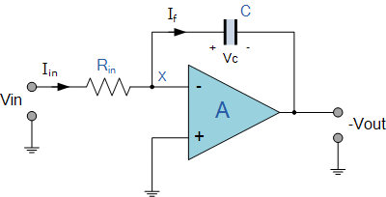
Integrator Function
An integrator circuit produces a steadily changing output voltage for a constant input voltage.
Notes:
An integrator circuit acts as an inverting amplifier whose output voltage in the negative integral is the same as the input voltage. It simulates mathematical integration thus giving it its name. The output time is determined by the time in which the voltage is present at the input using the capacitor as a feedback unit.

Slide 3
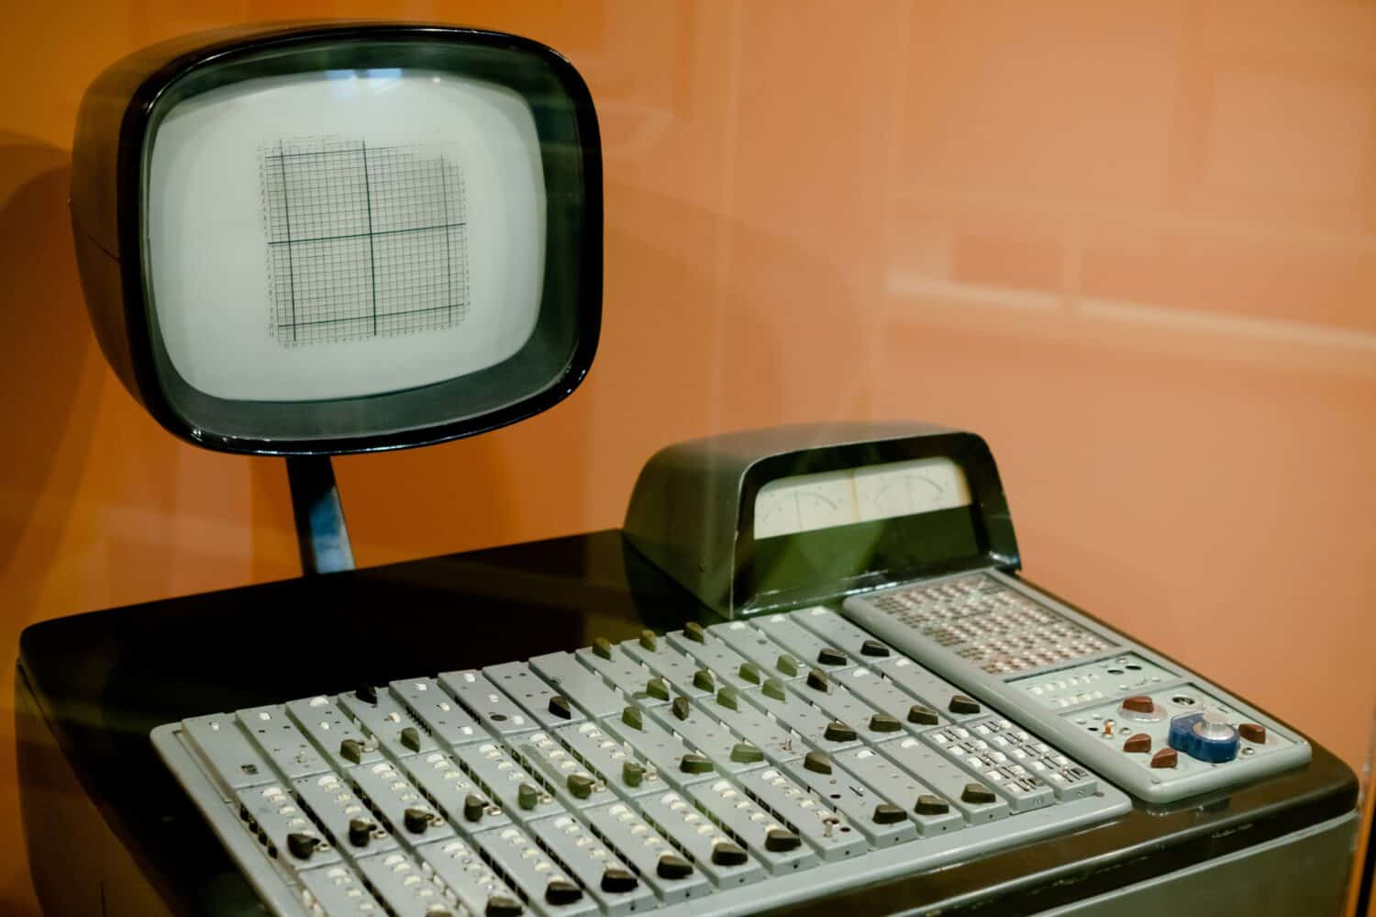
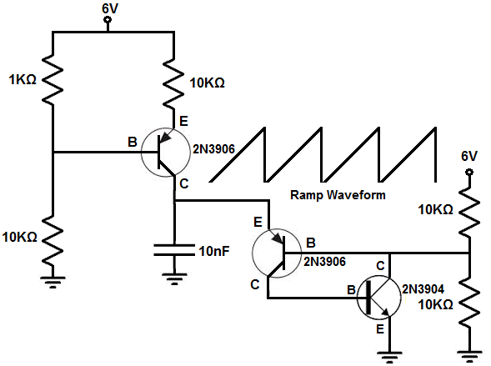
Where is it used?
Integrator Circuits are the back bone of analog electronics.
Examples include:
Analog computers
Ramp Generators
Notes:
Integrator Circuits are most commonly used in analog electronics such as analog computers. The circuit also is used when making ramp generators, wave shaping circuits, and A/D converters. Its use of mathematical integration it is able to convert waves.

Slide 4
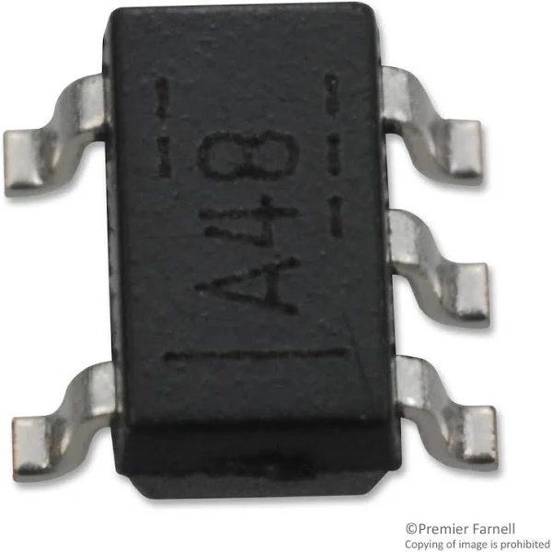
Advantages of an Integrator
Small in size
Simple layout
Low power requirements
Components all lie on a single chip
Notes:
Integrators have a large assortment of advantages. Some additional advantages from the ones listed above are the fact that it has good reliability since the circuit requires little amount of connections. The circuit is also cheap to make resulting in easy mass production. Finally, the circuit can operate in higher temperature ranges making it a very optimal tool.

Slide 5
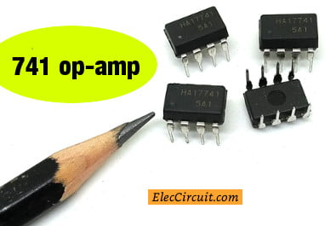
Disadvantages of an Integrator
Only external components are connected to circuit
Circuit cannot be modified
Notes:
Through its disadvantages, an integrator circuit does have qualities that can make it a bad choice. For instance a disadvantage that has not been listed is the fact that if any component in the circuit goes faulty, then the entire unit will need to be replaced rather than the one faulty variable. The mass production of this product does not make it hard to replace, however the act of needing to replace the entire unit over any minor flaw is certainly a detriment.

Slide 6
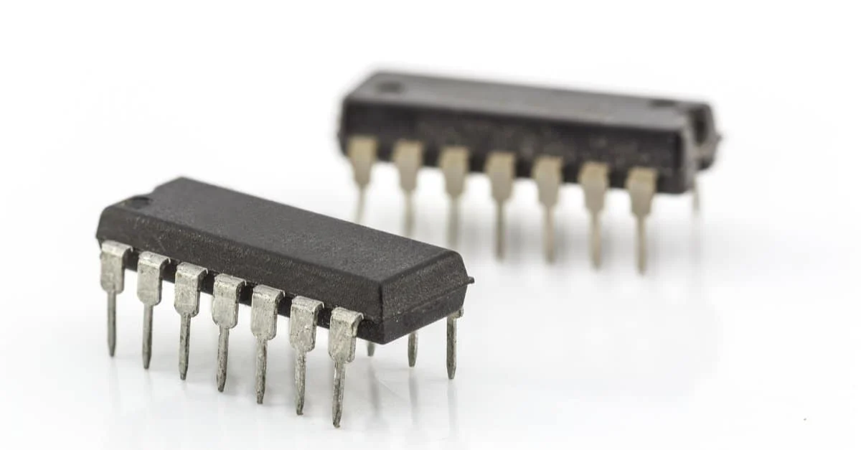
Variations of an Integrator
Thin and thick film ICs
Monolithic ICs
Hybrid or Multichip ICs
Notes:
There are three different types of integrator circuits. The first is thin and thick film ICs, these ICs have capacitors and resistors integrated in the circuit, but diodes and transistors are connected as a separate components. Monolithic ICs have all the components integrated on a silicon chip and they are the most common ICs used. Finally we have hybrid ICs, in these more than one individual chips are interconnected between each other.

Slide 7
References
Gupta, S. (2019, May 8). Operational Amplifier Integrator Circuit: Construction, working and applications. Op Amp Integrator Circuit: Construction, Working and Applications. https://circuitdigest.com/tutorial/op-amp-integrator-circuit-working-construction-applications
James, L. (2023, February 13). The applications of op-amp integrators. Power & Beyond. https://www.power-and-beyond.com/the-applications-of-op-amp-integrators-a-7cade59e08e0173d0cc04f923005316a/#:~:text=An%20integrating%20circuit%20is%20used,input%20voltage%20integrated%20over%20time.
Revolution, E. (2019, September 12). Advantages & disadvantages of Integrated Circuits. Electrical Revolution. https://www.myelectrical2015.com/2019/12/advantages-disadvantages-of-integrated.html
Storr, W. (2022, August 4). Op-amp integrator - the operational amplifier integrator. Basic Electronics Tutorials. https://www.electronics-tutorials.ws/opamp/opamp_6.html
Technology, E. (2018, November 8). Different types of integrated circuits (ICS) & Their Applications & Limitation. ELECTRICAL TECHNOLOGY. https://www.electricaltechnology.org/2015/04/types-of-ics-classification-of-integrated-circuits-and-their-limitation.html#types-of-ics-integrated-circuits

